Slide 1
Implementing and running CO model in g-CTMQC code using OpenMOLCAS for electronic structure calculations
Final Project for Cyber Training Workshop 2022
7/22/22
Julian Stetzler

Slide 2
Objectives
Overall goal: To obtain experience with g-CTMQC code and OpenMOLCAS
Run dynamics on CO using g-CTMQC
Requires electronic structure calculations which are performed in OpenMOLCAS
Results of electronic structure calculations will be used to parameterize PECs for CO

Slide 3
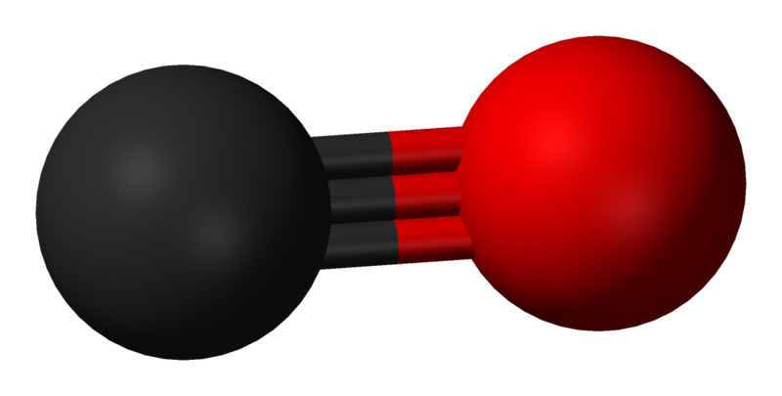
Model and Choice of Method
For the project, the model of interest was carbon monoxide
CO is a simple diatomic with one reaction coordinate and thus easy to parameterize
My research interests include exact factorization and thus the g-CTMQC code is a good choice for dynamics
Requires additional software
Pre-coded potentials
Analytic PES/PEC
g-CTMQC
Electronic Structure Software
Dynamics

Slide 4
Electronic Structure calculations
Molecular Orbital Diagram of CO
OpenMOLCAS with AN0-R3 basis set and (10,11) active space
Equilibrium geometry ground state energy was -113.21 hartrees close to literature value of -113.15 hartrees. SCF orbitals also agreed well with the MO diagram of CO
6σ*
2π*
2p
5σ
2p
1π
4σ*
2s
2s
C
3σ
O
Energy
CO
Peterson, K. and Woods, R., 1990. Theoretical dipole moment functions involving the a 3Π and a’ 3Σ+ states of carbon monoxide. J. Chem. Phys., 93(7), pp.5029-5036

Slide 5
Adibatic PECs
Presence of intruder states in some geometries towards the tail

Slide 6
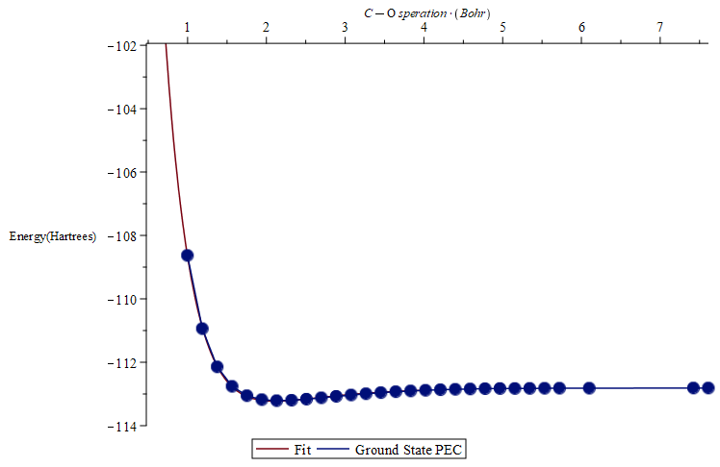
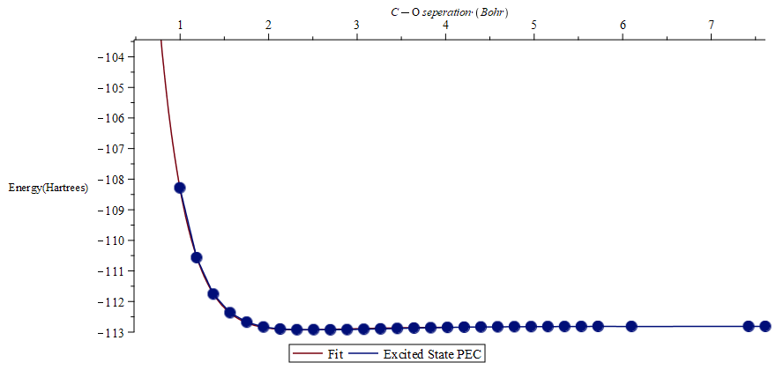
Adibatic PECs fitting
Fitting functions were generic morse oscillators

Slide 7
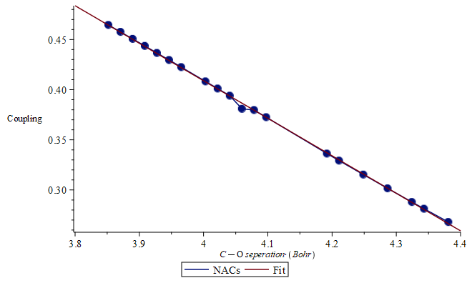
NACs fitting
NACs followed decaying linear trend
Likely needed a larger sample range

Slide 8
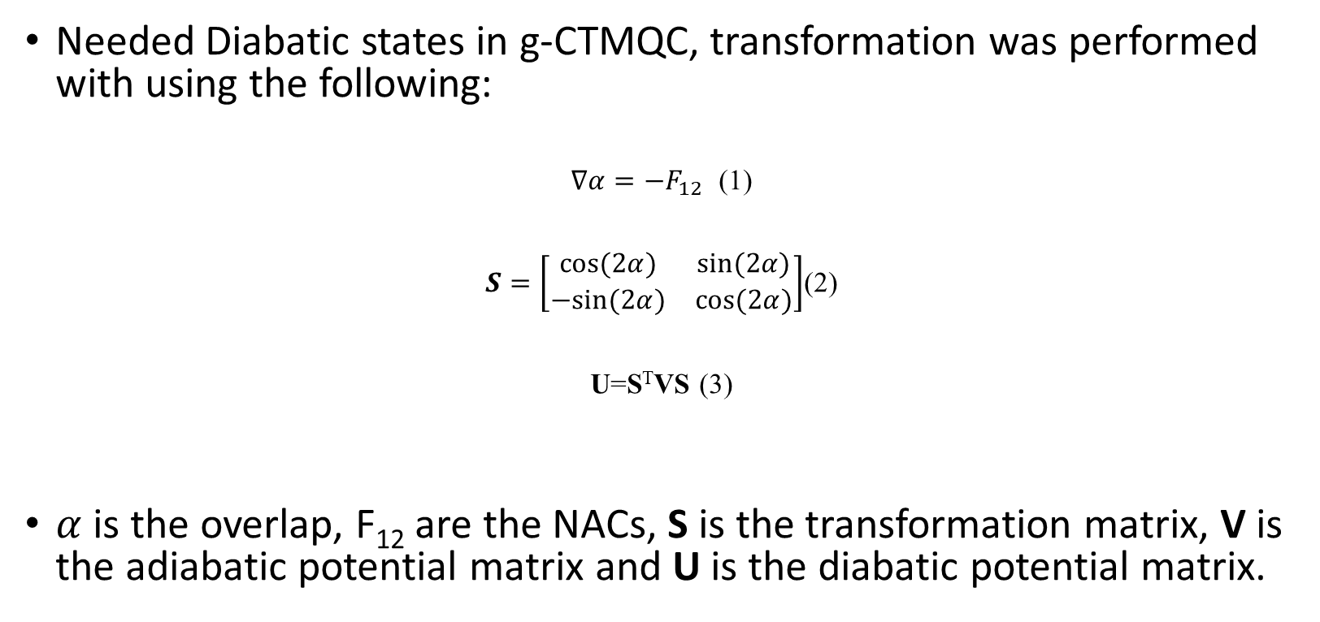
Adiabatic to Diabatic Transformation
Needed Diabatic states in g-CTMQC, transformation was performed with using the following:
$∇α=−F_{12}$ (1)
$S=\left[\begin{matrix}cos⁡(2α) & sin⁡(2α) \\ −sin⁡(2α) & cos⁡(2α)\end{matrix}\right]$(2)
U=S^{T}VS (3)
$α$ is the overlap, F₁₂ are the NACs, S is the transformation matrix, V is the adiabatic potential matrix and U is the diabatic potential matrix.
Köppel, H., 2004. DIABATIC REPRESENTATION: METHODS FOR THE CONSTRUCTION OF DIABATIC ELECTRONIC STATES. Advanced Series in Physical Chemistry, pp.175-204.

Slide 9
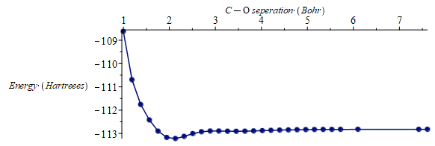
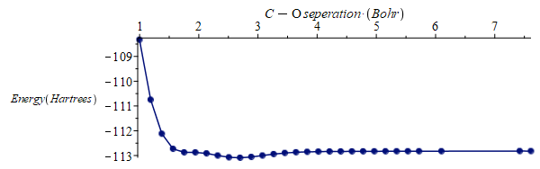
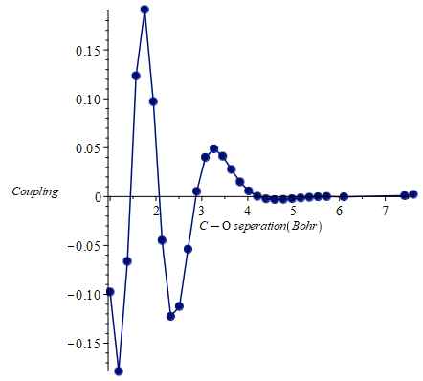
Diabatic Potentials
Ground
Excited
Coupling likely not accurate due to insufficient NAC scan

Slide 10
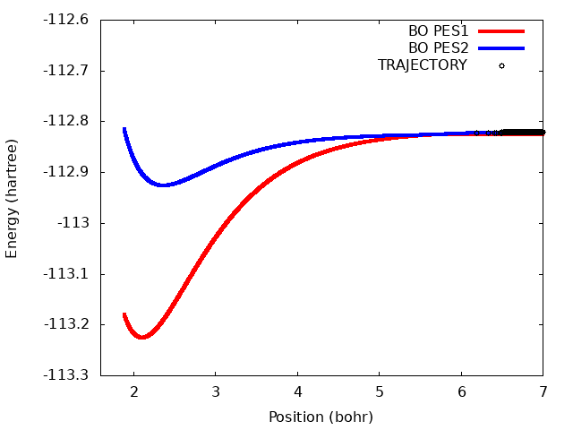
Nuclear Dynamics
CT-MQC
EHREN
TSFSH
CT-MQC and EHREN Behave somewhat similarly
TSFSH has longer lived excited state trajectories

Slide 11
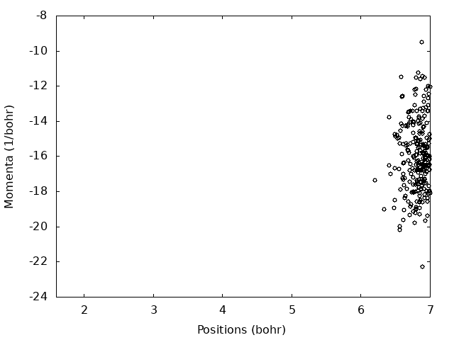
Phasespace
CT-MQC
EHREN
TSFSH
Similar qualitative result for average momentum and position over time
CT-MQC wave packet appears to remain less dispersed compared to Ehrenfest and especially the TSFSH

Slide 12
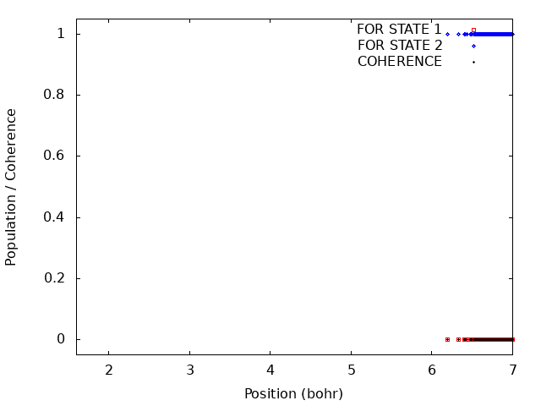
Population Dynamics
CT-MQC
EHREN
TSFSH
Similar coherences correct coupling region
CT-MQC has the fastest population transfer followed by Ehrenfest then TSFSH (similar to what we see in trajectories on the PECs)

Slide 13
Conclusion
Obtained some reasonable dynamics results from g-CTMQC for CO
Due to time-constraints unable to fully explore or optimize some parts of the method such as NACs and diabetic transformations
Regardless, overall goal of gaining experience with g-CTMQC code and OpenMOLCAS was successful

Slide 14
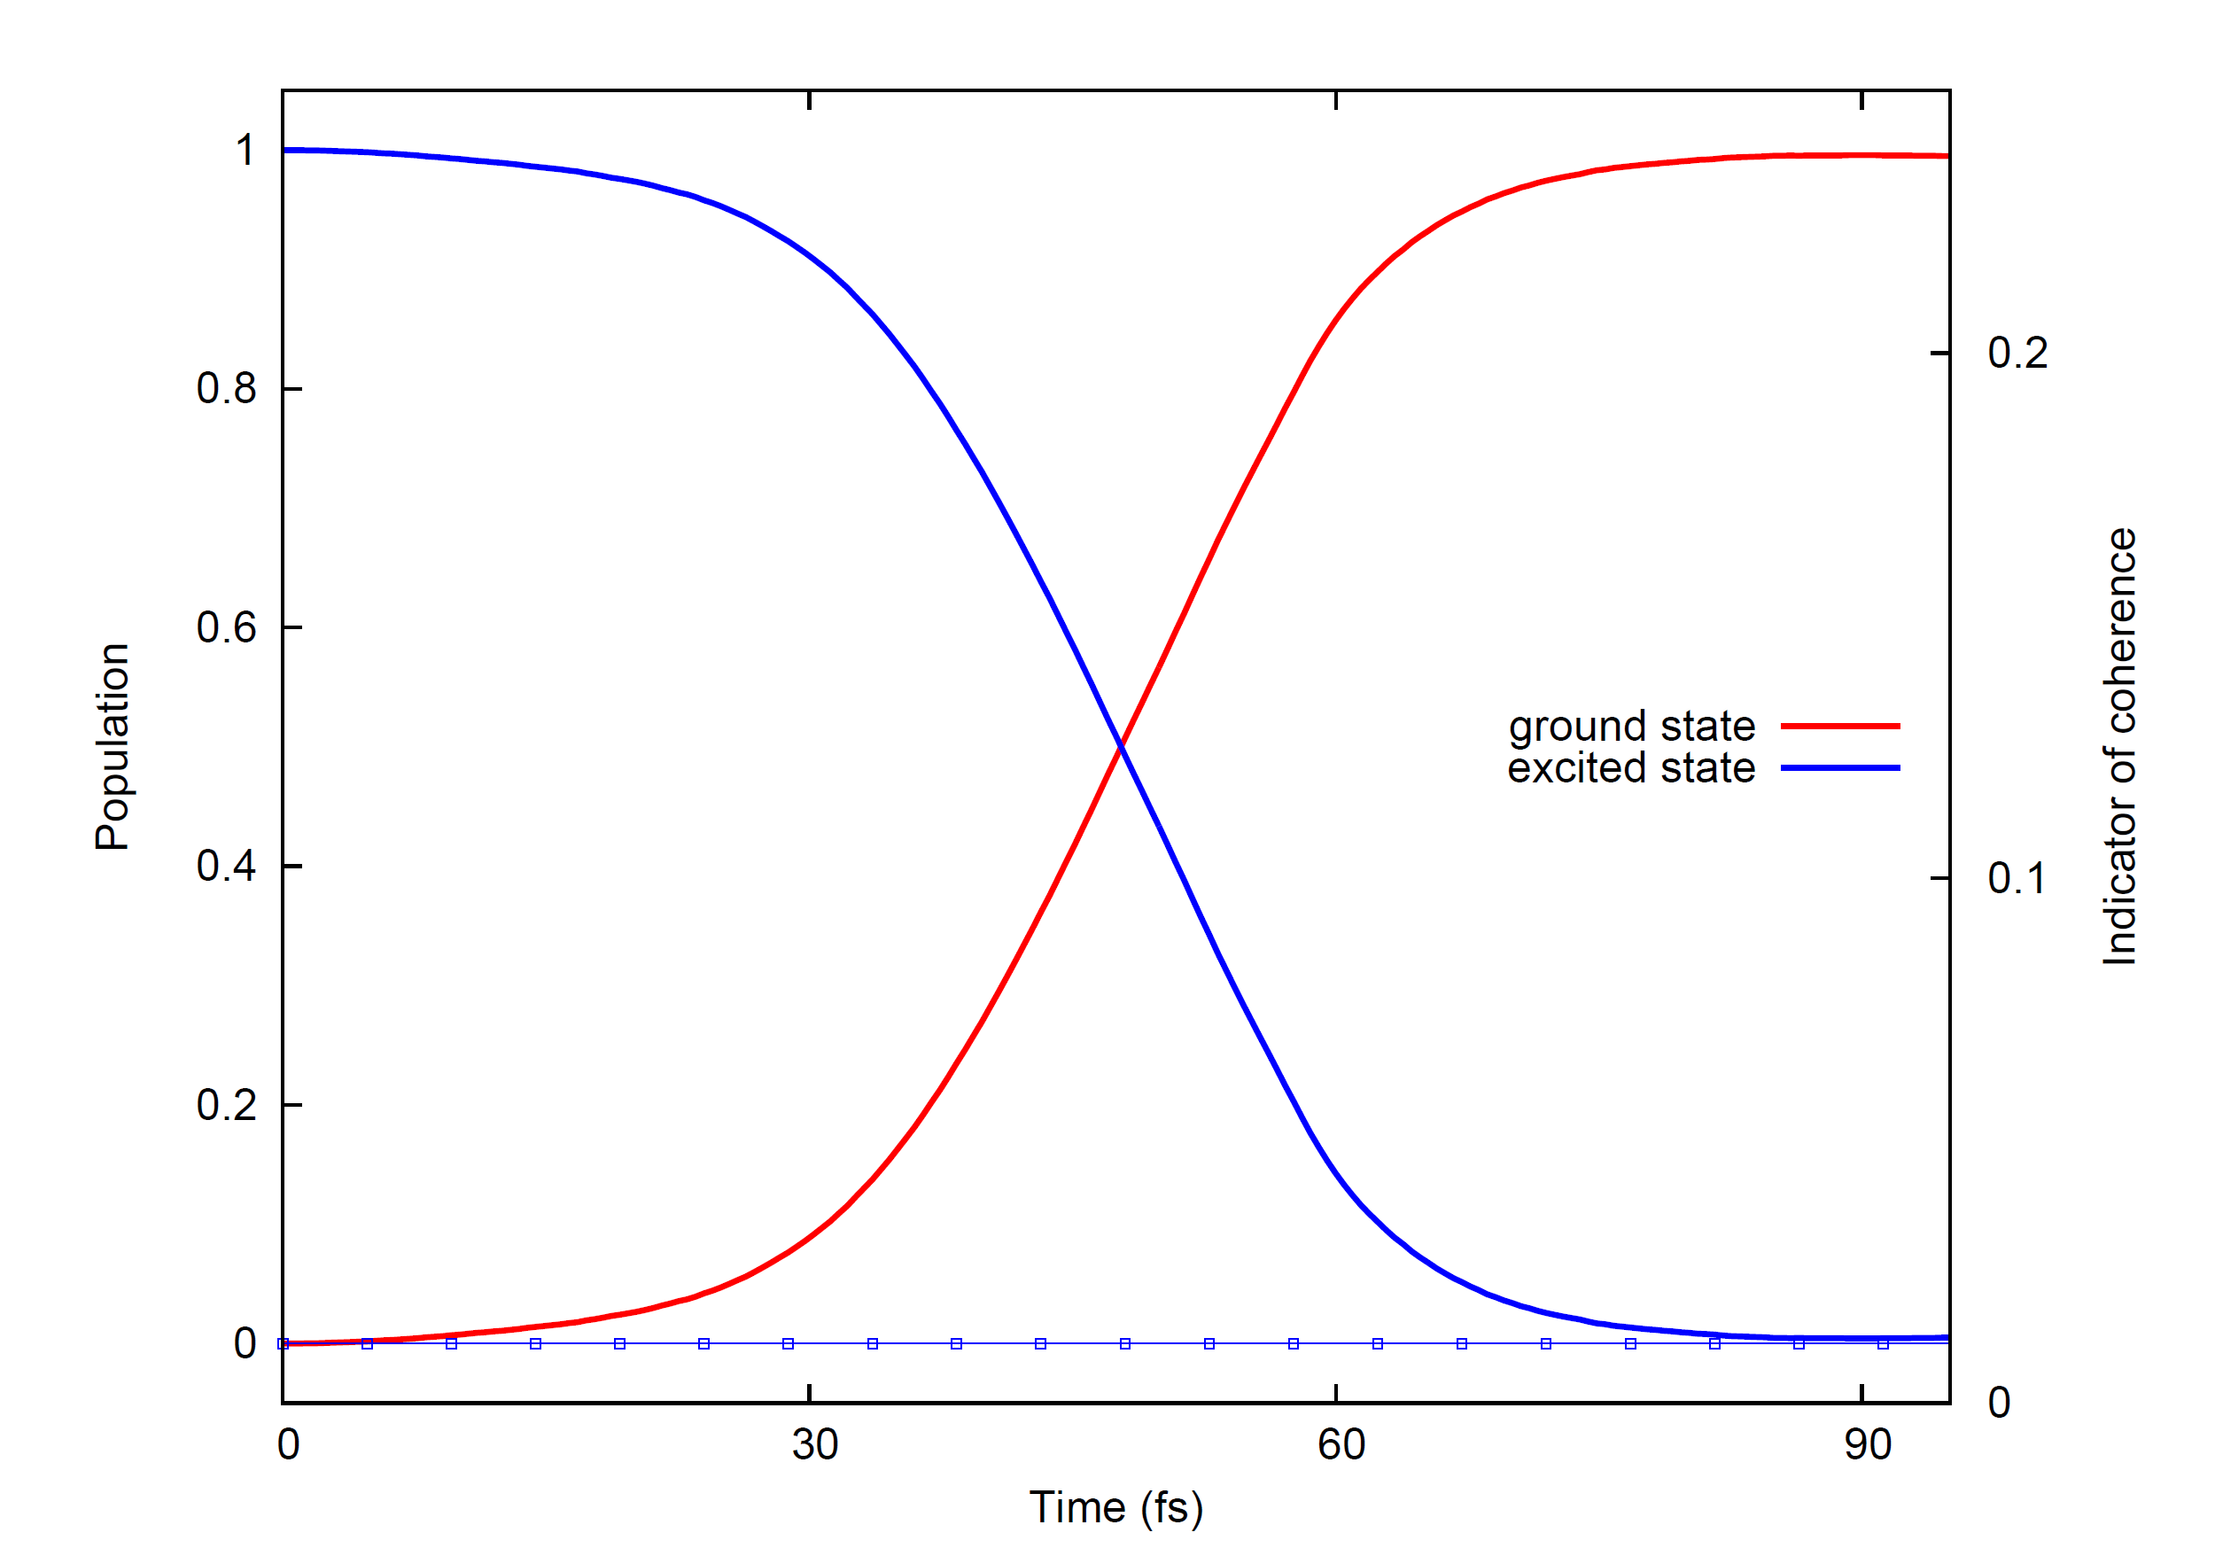
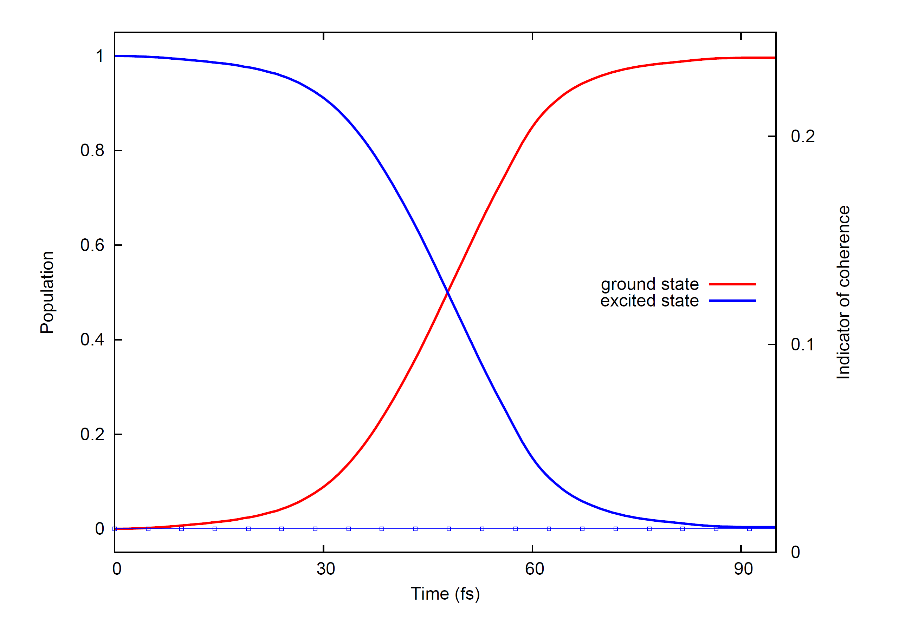
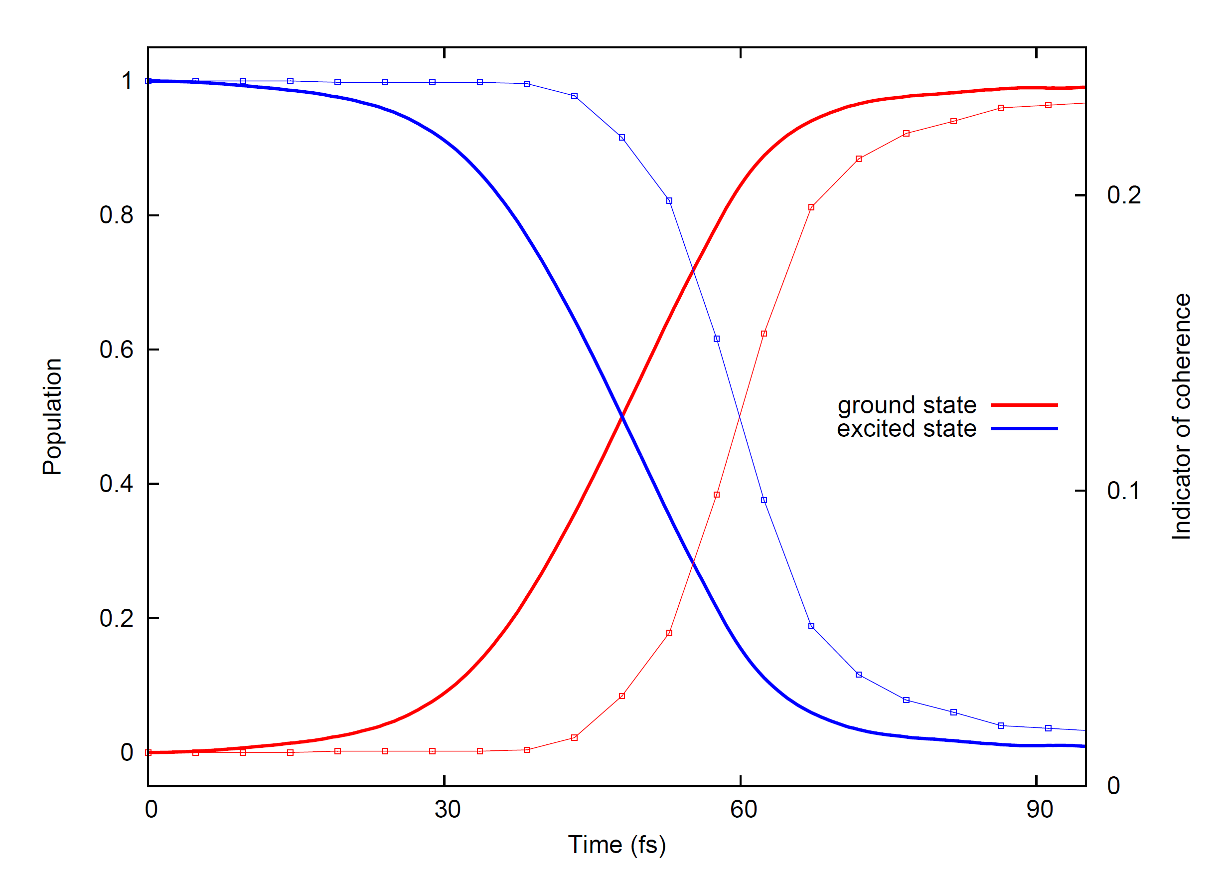
Populations-Backup
CT-MQC
EHREN
TSFSH

